Slide 1
Data Analytics Lifecycle
Data science projects differ from BI projects
  More exploratory in nature
  The project process is some what critical.
  Participants should be thorough and rigorous in the process
Break large projects into smaller pieces
Data Analytics Lifecycle defines the analytics process and best practices from discovery to project completion.

Slide 2
Data Analytics Lifecycle
Data Analytics lifecycle Phases:
Discovery Phase
Data Preparation Phase
Model Planning Phase
Model Building Phase
Communicate Result
Operationalize

Slide 3
Data Analytics Lifecycle
With six phases the project work can occur in several phases simultaneously
The cycle is iterative to portray a real project
Work can return to earlier phases as new information is uncovered

Slide 4
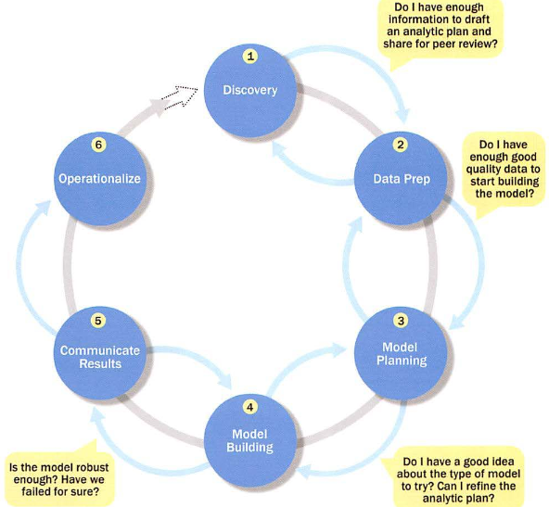
Data Analytics Lifecycle

Slide 5
Data Analytics Lifecycle
Phase – I: Discovery
  Learning the Business Domain
  Resources
  Framing the Problem
  Developing Initial Hypotheses
  Identifying Potential Data Sources

Slide 6
Data Analytics Lifecycle
Phase – 2: Data Preparation
  It requires analytical sandbox in which you can perform analytics for the entire duration of the project
  It includes steps to
    Explore
    Preprocess
    Conditional Data
  Data preparation tends to be the most labor-intensive step in the analytics lifecycle
    Often at least 50% of the data science project’s time
  The data preparation phase is a iterative process

Slide 7
Data Analytics Lifecycle
Phase – 2: Data Preparation
  In ETL users perform extract, transform, load
  Data Analytics lifecycle → ELT or ETLT → Extract, Transform, Load and Transform.
    early load preserves the raw data which can be useful to examine.
  Example :
    In credit card fraud detection, outliers can represent high-risk transactions that might be inadvertently filtered out or transformed before being loaded into the database

Slide 8
Data Analytics Lifecycle
Phase – 3: Model Planning
  This determines the methods and techniques to extract relationships among variables.
  These relationship patterns will set the base for algorithms which will be used in next phase
  It uses Exploratory Data Analysis (EDA) using various statistical formulae and visualization tools.
  Simply, it identifies candidate models to apply to the data for clustering, classifying, or finding relationships in data.

Slide 9
Data Analytics Lifecycle
Phase – 3: Model Planning
  Activities to consider:
    Assess the structure of the data
    Ensure the analytic techniques enable the team to meet the business objectives and accept or reject the working hypotheses
    Determine if the situation warrants a single model or a series of techniques as part of a larger analytic workflow
    Research and understand how other analysts have approached this kind or similar kind of problem

Slide 10
Data Analytics Lifecycle
Phase – 4: Model Building
  Execute the models defined in Phase 3
  Develop datasets for training, testing, and production
  Develop analytic model on training data, test on test data.
  It will consider whether your existing tools will suffice for running the models or it will need a more robust environment (like fast and parallel processing).
  You will analyze various learning techniques like classification, association and clustering to build the model.

Slide 11
Data Analytics Lifecycle
Phase – 5: Communicate Results
  Determine if the team succeeded or failed in its objectives
  Assess if the results are statistically significant and valid
    If so, identify aspects of the results that present salient findings
    Identify surprising results and those in line with the hypotheses
  Communicate and document the key findings and major insights derived from the analysis
  This is the most visible portion of the process to the outside stakeholders and sponsors

Slide 12
Data Analytics Lifecycle
Phase – 6: Operationalize
  In this last phase, the team communicates the benefits of the project more broadly and sets up a pilot project to deploy the work in a controlled way
  Risk is managed effectively by undertaking small scope, pilot deployment before a wide-scale rollout
  During the pilot project, the team may need to execute the algorithm more efficiently in the database

